Slide 1
ERA general approach to level crossing safety
Kirsi Pajunen
European Railway Agency

Slide 2
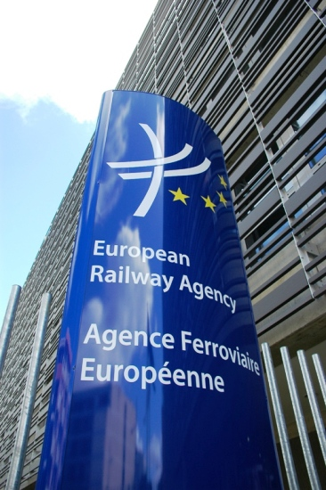
European Railway Agency
To support the competitiveness of railway traffic in EU
To promote safe and fluent railway traffic in EU
Safety
Interoperability (harmonising the technical systems)
Approach to level crossing safety based on Railway Safety Directive

Slide 3
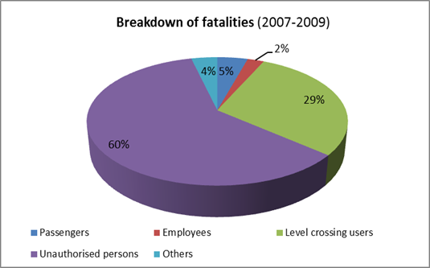
Fatalities in railway accidents in EU
Level crossing user fatalities 1.7% of road fatalities

Slide 4
General approach
Long term aim: Vision zero
The design, function and use of the transport system shall be aligned to that no one is killed or seriously injured
Human being is a part of transport system – transport system is there for the people
Human error should not be punished by death
People do not necessarily react to safety improvement measures as planned
Notes:
CONSIDERS that the level of road fatalities and injuries remain unacceptably high and STRESSES the importance of adapting motorways, roads, streets and vehicles to human capacity; thereby AIMING towards the long-term ”zero-vision” for European road transport
safety; (EU Council conclusions on road safety, Dec 2010 )

Slide 5
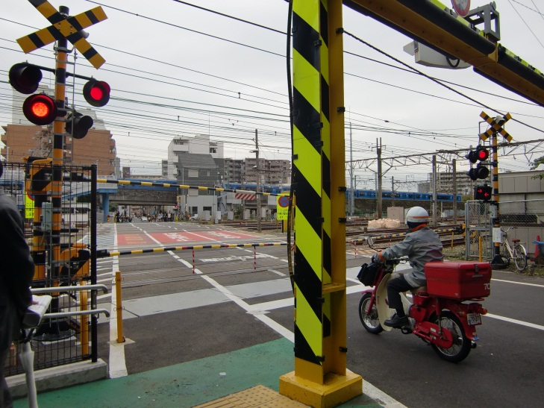
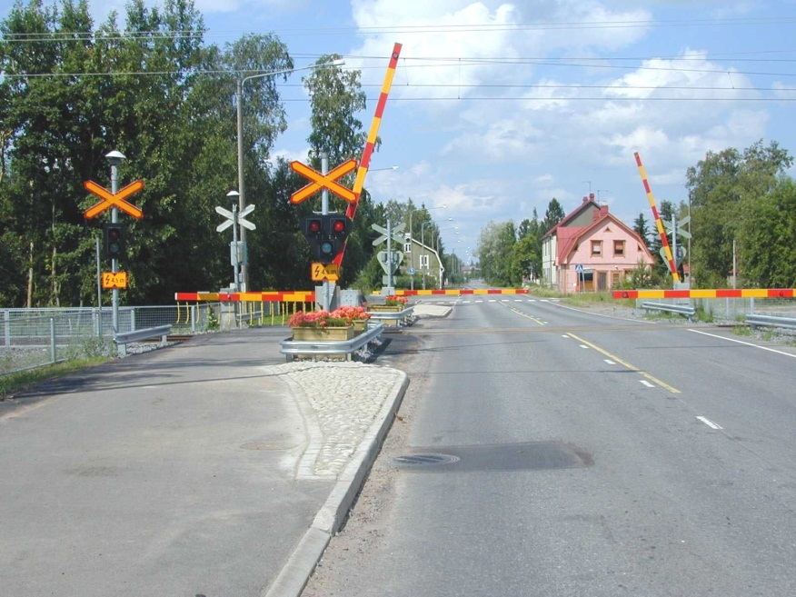
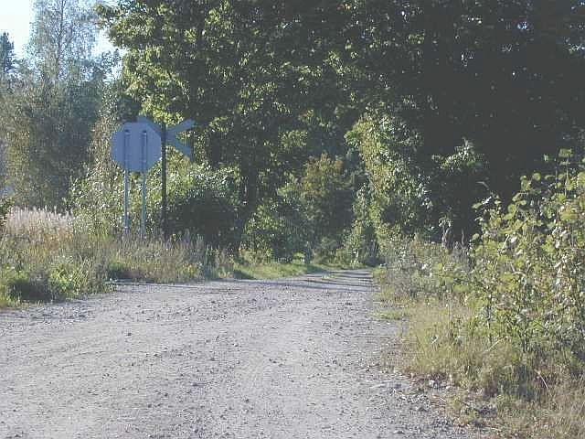
Design in practice

Slide 6
% of LCs in EU with automatic or manual protection

Slide 7
Approach to level crossing safety
Need of cooperation
Railway stakeholders (especially infrastructure managers)
Road administrators (Road administration, communities, private road owners)
Police
Emergency response units
Communities (societal problem)
Accident investigation bodies
Ministries
…

Slide 8
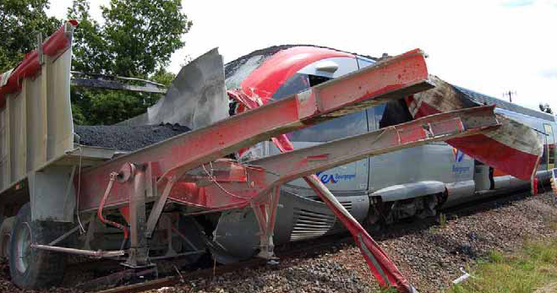
Approach to level crossing safety (cont.)
Agreement on sharing the costs of safety improving measures
Design
Maintenance
Accident investigation -> recommendations to improve safety

Slide 9
Accident investigation
Level crossings accidents must be investigated when they result in the death of at least one person or serious injuries to five or more persons or extensive damage
and
have an obvious impact on railway safety regulation or the management of safety

Slide 10
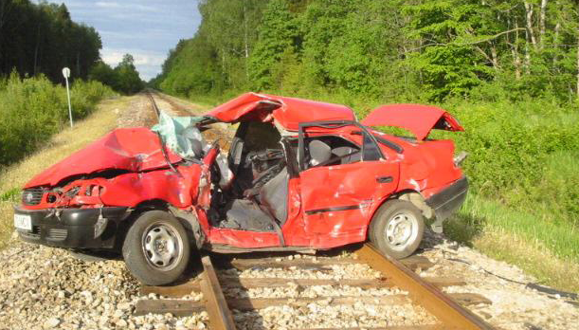
Accident investigation (cont.)
Non-permitted entry onto a level crossing is a widely spread issue -> these cases should not be excluded by default from investigation
Even in the case of an obvious violation of safety rules, the causal factor may originate from the railway system
Often poor visibility conditions, poor signs or signals or poor design of the level crossing influences the level crossing user’s behaviour

Slide 11
At ERA
Level crossing safety connected to safety performance
Safety indicators, safety targets, safety performance report
Under the umbrella of Safety performance working party
National safety authorities
Sector associations
Eurostat

Slide 12
ERA data analysis
Accident investigation report analysis
About 160 reports since 2006
Causes to accidents
Recommendations to improve safety
Common Safety Indicator data
Trends in level crossing indicators
Common Safety Target data

Slide 13
Level crossing group
Identification of good practises
Effects of safety improving measures
Input to regulation
Basic requirements on level crossings into European regulation?
…

Slide 14
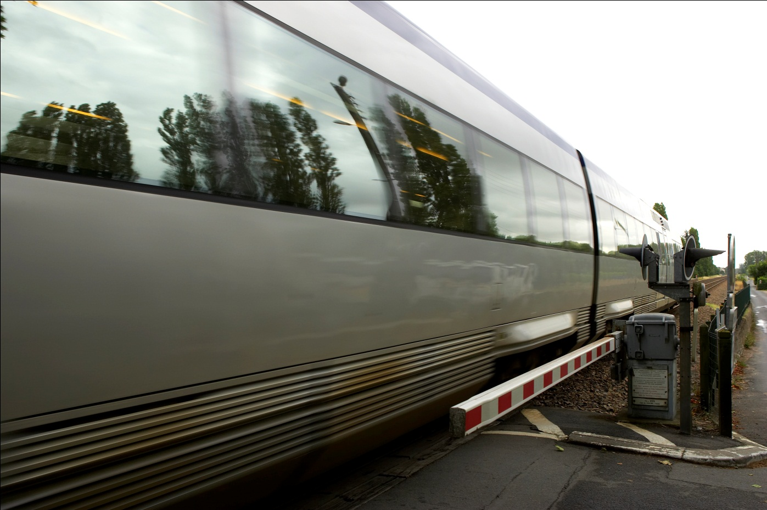
Thank you for your attention!
Contact: kirsi.pajunen@era.europa.eu

